Slide 1

Graph Theory and Its Applications
Nodes, Properties, Relationships, Labels
Dr. Arti Arya
Department of Computer Science
and Engineering

Slide 2

GRAPH THEORY, APPLICATIONS AND COMBINATORICS
Nodes, Properties, Relationships, Labels
Dr. Arti Arya
Department of Computer Science & Engineering

Slide 3

Graph Theory and its Applications Acknowledgement
The slides are prepared by Dr. Surabhi Narayan and her TA Ms. Hita Juneja and a lot of inputs are added by Dr. Arti Arya. The sources of the information other than textbook is mentioned wherever used.

Slide 4
Graph Theory, Applications and Combinatorics
Nodes, Properties, Relationships, Labels
Using Cypher to programmatically describe graphs
Cypher is an expressive (yet compact) graph database query language.
Cypher is unique because it provides a visual way of matching patterns and relationships.
Neo4j users use Cypher to construct expressive and efficient queries to do any kind of create, read, update, or delete (CRUD) on their graph, and Cypher is the primary interface for Neo4j.

Slide 5

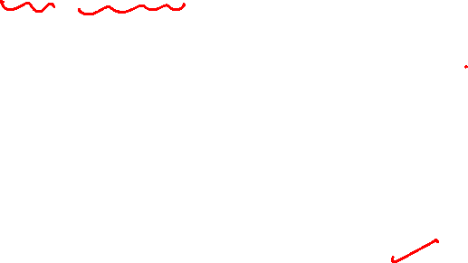
Graph Theory, Applications and Combinatorics
Using Cypher to programmatically describe graphs
Cypher uses an ASCII-art type of syntax where
(nodes)-[:ARE_CONNECTED_TO]->(other Nodes) using rounded brackets for circular (nodes), and -[:ARROWS]-> for relationships.
ASCII art is a type of syntax that uses ASCII characters to create images or text effects.
When you write a query, you draw a graph pattern through your data.
ASCII art is a graphic design technique that uses computers for presentation and consists of pictures pieced together from the 95 printable (from a total of 128) characters defined by the ASCII Standard from 1963 and ASCII compliant character sets with proprietary extended characters (beyond the 128 characters of standard 7-bit ASCII).
The term is also loosely used to refer to text-based visual art in general.

Slide 6
Graph Theory, Applications and Combinatorics
FYI
Some common styles are:
Black Outline: This style uses only the characters █ and ░ to create a black outline of the text or image. For example:
████████████████████████
█▄▄░▄▄█░▄▄█░█░█▄░▄████░▄▄▄█░▄▀██▄██▄░▄█▀▄▄▀█░▄▄▀
███░███░▄▄█▀▄▀██░█████░▄▄▄█░█░██░▄██░██░██░█░▀▀▄
███░███▄▄▄█▄█▄██▄█████░▀▀▀█▄▄██▄▄▄██▄███▄▄██▄█▄

Slide 7
Graph Theory, Applications and Combinatorics
FYI
Some common styles are:
Small Negative Filled: This style uses the characters ▀, ▐, ▌, ▬, and █ to create a small negative filled text or image. For example:
▬ ▬ ▬ ▬ ▬ ▬ ▬ ▬ ▬ ▬ ▬ ▬ ▬ ▬
█ █ █ █ █ █ █ █ █ █ █ █ █ █
▐ ▐ ▐ ▐ ▐ ▐ ▐ ▐ ▐ ▐ ▐ ▐
█ █ █ █ █ █ █ █ █ █
▌ ▌ ▌ ▌ ▌
█ █ █ █
▌ ▌ ▌
█ █
▌
█

Slide 8
Graph Database
Cypher is an expressive (yet compact) graph database query language. Although currently specific to Neo4j, its close affinity with our habit of representing graphs as diagrams makes it ideal for programmatically describing graphs
Other languages include SPARQL and Gremlin
Commands/Clauses:
1. MATCH: The MATCH clause is at the heart of most Cypher queries. MATCH can retrieve all nodes in the Neo4j database.
2. RETURN: This clause specifies which nodes, relationships, and properties in the matched data should be returned to the client.
3. WHERE: Provides criteria for filtering pattern matching results.
4. CREATE and CREATE UNIQUE: Create nodes and relationships.

Slide 9
Graph Database
5. MERGE: Ensures that the supplied pattern exists in the graph, either by reusing existing nodes and relationships that match the supplied predicates, or by creating new nodes and relationships.
6. DELETE: Removes nodes, relationships, and properties.
7. SET: Sets property values.
8. FOREACH: Performs an updating action for each element in a list.
9. UNION: Merges results from two or more queries.
10. WITH: Chains subsequent query parts and forwards results from one to the next. Similar to piping commands in Unix.

Slide 10
Graph Database
RETURN: This clause is used to define what to include in the query result set.
ORDER BY: This clause is used to arrange the output of a query in order. It is used along with the clauses RETURN or WITH.
LIMIT: This clause is used to limit the rows in the result to a specific value.
SKIP: This clause is used to define from which row to start including the rows in the output.

Slide 11
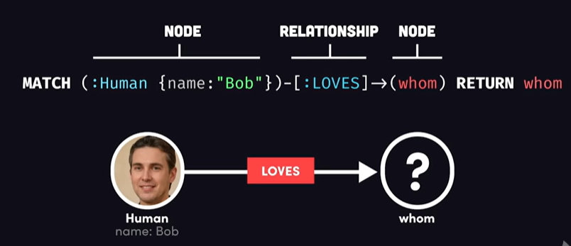
Graph Database
Create a single node
Create multiple nodes
Create a node with a label
Create a node with multiple labels
Create a node with properties
Returning the created node
Neo4j CQL - Creating Nodes (tutorialspoint.com)

Slide 12
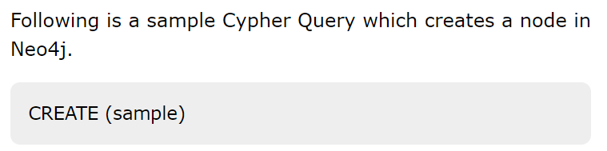
Graph Database
Creating a Single node
You can create a node in Neo4j by simply specifying the name of the node that is to be created along with the CREATE clause.
CREATE (node_name);
To verify the creation of the node, type and execute the following query in the dollar prompt:
Semicolon (;) is optional.
MATCH (n) RETURN n

Slide 13
Graph Database
Creating Multiple Nodes
The create clause of Neo4j CQL is also used to create multiple nodes at the same time. To do so, you need to pass the names of the nodes to be created, separated by a comma.
CREATE (node1),(node2);

Slide 14

Graph Database
Creating a Node with a Label
A label in Neo4j is used to group (classify) the nodes using labels. You can create a label for a node in Neo4j using the CREATE clause.
E.g. create(Sarvagya: Player)
To verify the creation of the node, type and execute the following query in the dollar prompt:
CREATE (node:label)
MATCH (n) RETURN n

Slide 15
Graph Database
Creating a Node with Multiple Labels
You can also create multiple labels for a single node. You need to specify the labels for the node by separating them with a colon “ : ”.
CREATE (node:label1:label2:. . . . labeln)
Following is a sample Cypher Query which creates a node with multiple labels in Neo4j.
CREATE (Dhawan:person:player)

Slide 16
Graph Database
Create Node with Properties
Properties are the key-value pairs using which a node stores data. You can create a node with properties using the CREATE clause. You need to specify these properties separated by commas within the flower braces “{ }”.
E.g.
CREATE (node:label { key1: value, key2: value, . . . . . . . . . })
CREATE (Dhawan:player{name: "Shikar Dhawan", YOB: 1985, POB: "Delhi"})

Slide 17
Graph Database
Creating Relationships
We can create a relationship using the CREATE clause. We will specify relationship within the square braces “[ ]” depending on the direction of the relationship it is placed between hyphen “ - ” and arrow “ → ” as shown in the following syntax.
CREATE (node1)-[:RelationshipType]->(node2)
MATCH (a:LabeofNode1), (b:LabeofNode2) WHERE a.name = "nameofnode1" AND b.name = " nameofnode2" CREATE (a)-[: Relation]->(b) RETURN a,b

Slide 18
Graph Database
Creating a Complete Path
In Neo4j, a path is formed using continuous relationships. A path can be created using the create clause.
CREATE p = (Node1 {properties})-[:Relationship_Type]-> (Node2 {properties})[:Relationship_Type]->(Node3 {properties}) RETURN p

Slide 19
Graph Database
Merge a node with label
Merge a node with properties
OnCreate and OnMatch
Merge a relationship

Slide 20
Graph Database
the syntax for the MERGE command
MERGE (node: label {properties . . . . . . . })
CREATE (Dhawan:player{name: "Shikar Dhawan", YOB: 1985, POB: "Delhi"})
CREATE (Ind:Country {name: "India"})
CREATE (Dhawan)-[r:BATSMAN_OF]->(Ind)

Slide 21
Graph Database
Merging a Node with a Label
You can merge a node in the database based on the label using the MERGE clause. If you try to merge a node based on the label, then Neo4j verifies whether there exists any node with the given label. If not, the current node will be created.
MERGE (node:label) RETURN node
MERGE (Jadeja:player) RETURN Jadeja
MERGE (CT2013:Tournament{name: "ICC Champions Trophy 2013"})
RETURN CT2013, labels(CT2013)

Slide 22
Graph Theory, Applications and Combinatorics
Nodes, Properties, Relationships, Labels
Cypher Clauses
CREATE - This clause is used to create nodes, relationships, and properties.
WHERE - Provides criteria for filtering pattern matching results.
MERGE - This clause verifies whether the specified pattern exists in the graph. If not, it creates the pattern.
SET - This clause is used to update labels on nodes, properties on nodes and relationships.
DELETE - This clause is used to delete nodes and relationships or paths etc. from the graph.
REMOVE - This clause is used to remove properties and elements from nodes and relationships.

Slide 23
Graph Theory, Applications and Combinatorics
Nodes, Properties, Relationships, Labels
MATCH - The MATCH keyword searches for an existing node, relationship, label, property,
or pattern in the database. If you are familiar with SQL, MATCH works similar to SELECT in SQL.
FOREACH - This class is used to update the data within a list.
RETURN - This clause is used to define what to include in the query result set. You can tell Cypher to return nodes, relationships, node and relationship properties, or patterns in your query results. RETURN is not required when doing write procedures, but is needed for reads.
ORDER BY - This clause is used to arrange the output of a query in order. It is used along with the clauses RETURN or WITH.
LIMIT - This clause is used to limit the rows in the result to a specific value.
SKIP - This clause is used to define from which row to start including the rows in the output.

Slide 24

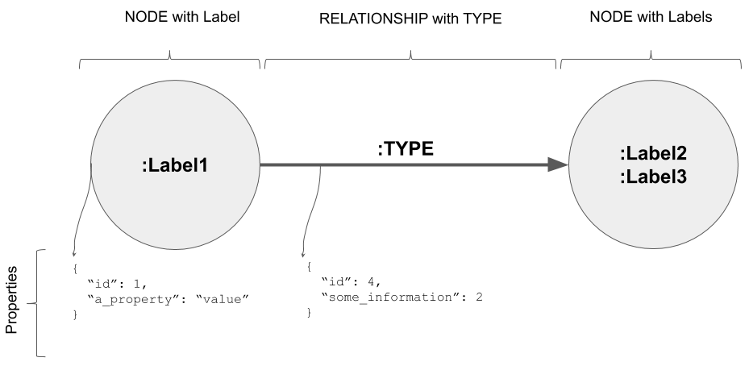
Graph Theory, Applications and Combinatorics
Nodes, Properties, Relationships, Labels

Slide 25
Graph Theory, Applications and Combinatorics
Nodes, Properties, Relationships, Labels
Let’s look at a sample movies dataset and make some queries on the same.
CQL CREATE Command
CREATE (TheMatrix:Movie {title:'The Matrix', released:1999, tagline:'Welcome to the Real World'})
CREATE (Keanu:Person {name:'Keanu Reeves', born:1964})
CREATE (Carrie:Person {name:'Carrie-Anne Moss', born:1967})
CREATE (Laurence:Person {name:'Laurence Fishburne', born:1961})
CREATE (Hugo:Person {name:'Hugo Weaving', born:1960})
CREATE (LillyW:Person {name:'Lilly Wachowski', born:1967})
CREATE (LanaW:Person {name:'Lana Wachowski', born:1965})
CREATE (JoelS:Person {name:'Joel Silver', born:1952})
CREATE
(Keanu)-[:ACTED_IN {roles:['Neo']}]->(TheMatrix),
(Carrie)-[:ACTED_IN {roles:['Trinity']}]->(TheMatrix),
(Laurence)-[:ACTED_IN {roles:['Morpheus']}]->(TheMatrix),
(Hugo)-[:ACTED_IN {roles:['Agent Smith']}]->(TheMatrix),
(LillyW)-[:DIRECTED]->(TheMatrix),
(LanaW)-[:DIRECTED]->(TheMatrix),
(JoelS)-[:PRODUCED]->(TheMatrix)
CREATE (Emil:Person {name:"Emil Eifrem", born:1978})
CREATE (Emil)-[:ACTED_IN {roles:["Emil"]}]->(TheMatrix)
.
.
.
.
.
.
https://neo4j.com/docs/getting-started/appendix/example-data/

Slide 26
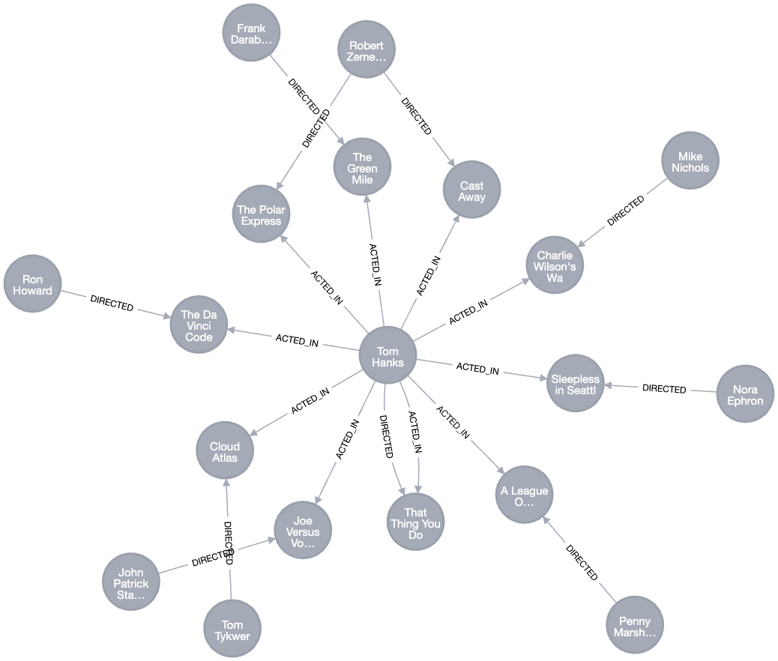
Graph Theory, Applications and Combinatorics
Nodes, Properties, Relationships, Labels

Slide 27
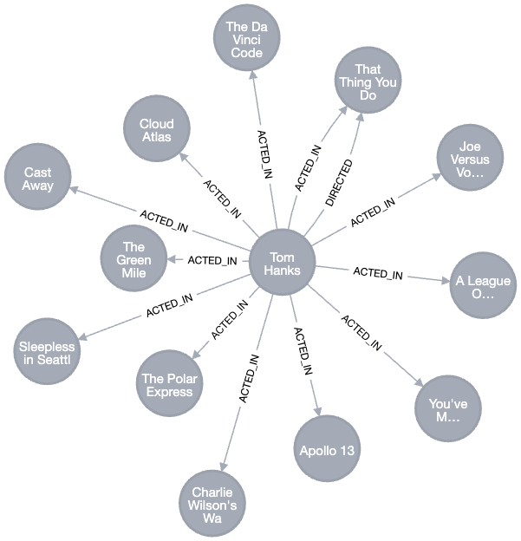

Graph Theory, Applications and Combinatorics
Nodes, Properties, Relationships, Labels
Find the actor named "Tom Hanks"
MATCH (tom {name: "Tom Hanks"})
RETURN tom
Find all movie Tom Hanks has acted in
MATCH (tom:Person {name: "Tom Hanks"})-[:ACTED_IN]->(tomHanksMovies)
RETURN tom,tomHanksMovies
https://neo4j.com/docs/getting-started/cypher-intro/patterns-in-practice/
https://neo4j.com/docs/getting-started/cypher-intro/subqueries/

Slide 28
╒════════════════════════╕
│nineties.title │
╞════════════════════════╡
│"The Matrix" │
├────────────────────────┤
│"The Devil's Advocate" │
├────────────────────────┤
│"A Few Good Men" │
├────────────────────────┤
│"As Good as It Gets" │
├────────────────────────┤
│"What Dreams May Come" │
├────────────────────────┤
│"Snow Falling on Cedars"│
├────────────────────────┤
│"You've Got Mail" │
├────────────────────────┤
│"Sleepless in Seattle" │
├────────────────────────┤
│"Joe Versus the Volcano"│
├────────────────────────┤
│"When Harry Met Sally" │
├────────────────────────┤
│"That Thing You Do" │
├────────────────────────┤
│"The Birdcage" │
├────────────────────────┤
│"Unforgiven" │
├────────────────────────┤
│"Johnny Mnemonic" │
├────────────────────────┤
│"The Green Mile" │
├────────────────────────┤
│"Hoffa" │
├────────────────────────┤
│"Apollo 13" │
├────────────────────────┤
│"Twister" │
├────────────────────────┤
│"Bicentennial Man" │
├────────────────────────┤
│"A League of Their Own" │
└────────────────────────┘
Graph Theory, Applications and Combinatorics
Nodes, Properties, Relationships, Labels
Find all movies released in the 1990s
MATCH (nineties:Movie) WHERE nineties.released >= 1990 AND nineties.released < 2000 RETURN nineties.title

Slide 29
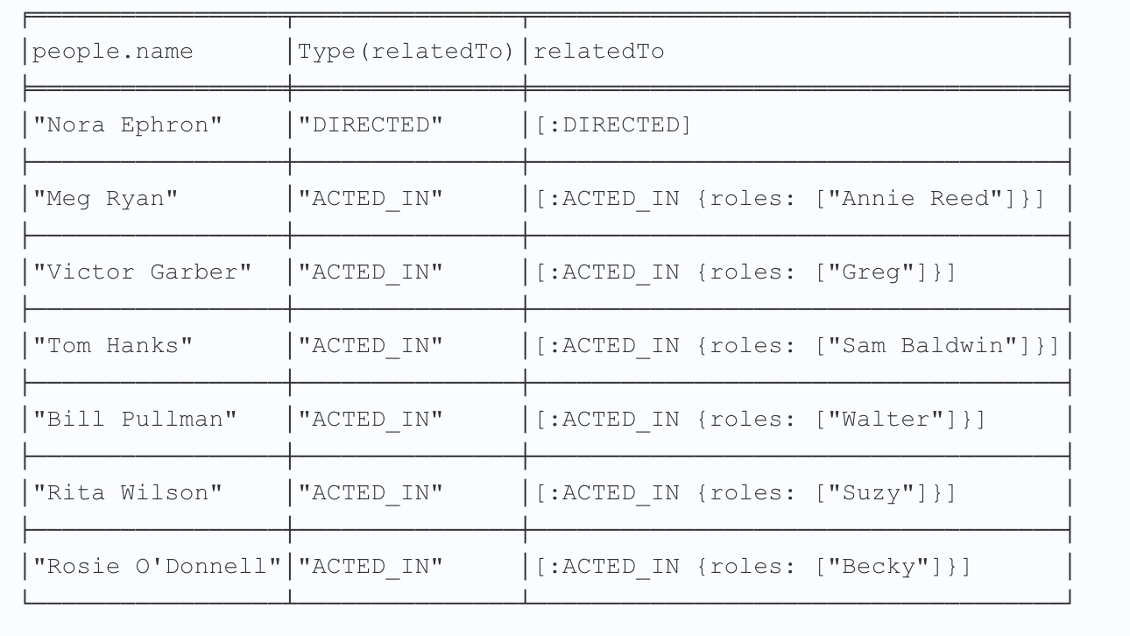
Graph Theory, Applications and Combinatorics
Nodes, Properties, Relationships, Labels
Find how many people are related to the
movie Sleepless in Seattle
MATCH (people:Person)-[relatedTo]-(:Movie {title: "Sleepless in Seattle"})
RETURN people.name, Type(relatedTo), relatedTo

Slide 30
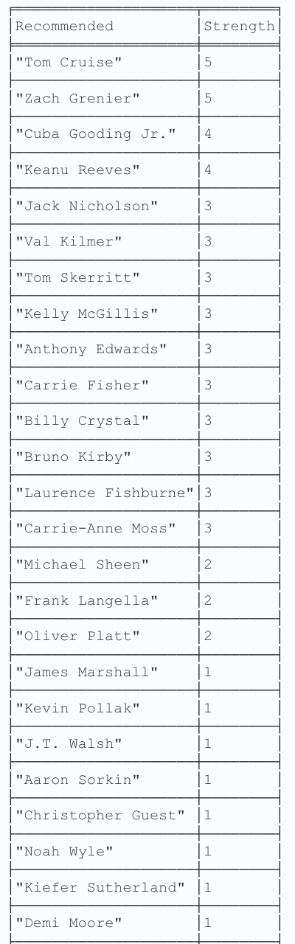
Graph Theory, Applications and Combinatorics
Nodes, Properties, Relationships, Labels
Recommend new co-actors for Tom Hanks.
A basic recommendation approach is to find connections past an immediate neighborhood which are themselves well connected.
MATCH (tom:Person {name:"Tom Hanks"})-[:ACTED_IN]->(m)<-[:ACTED_IN]-(coActors),
(coActors)-[:ACTED_IN]->(m2)<-[:ACTED_IN]-(cocoActors)
WHERE NOT (tom)-[:ACTED_IN]->()<-[:ACTED_IN]-(cocoActors) AND tom <> cocoActors
RETURN cocoActors.name AS Recommended, count(*) AS Strength ORDER BY Strength DESC
This query identifies co-actors of "Tom Hanks" and then finds co-actors of those co-actors who have not acted in the same movies as "Tom Hanks." It ranks these co-actors based on the number of shared movie appearances, with the most common co-actors appearing first in the results.
╒════════════════════╤════════╕
│Recommended │Strength│
╞════════════════════╪════════╡
│"Tom Cruise" │5 │
├────────────────────┼────────┤
│"Zach Grenier" │5 │
├────────────────────┼────────┤
│"Cuba Gooding Jr." │4 │
├────────────────────┼────────┤
│"Keanu Reeves" │4 │
├────────────────────┼────────┤
│"Jack Nicholson" │3 │
├────────────────────┼────────┤
│"Val Kilmer" │3 │
├────────────────────┼────────┤
│"Tom Skerritt" │3 │
├────────────────────┼────────┤
│"Kelly McGillis" │3 │
├────────────────────┼────────┤
│"Anthony Edwards" │3 │
├────────────────────┼────────┤
│"Carrie Fisher" │3 │
├────────────────────┼────────┤
│"Billy Crystal" │3 │
├────────────────────┼────────┤
│"Bruno Kirby" │3 │
├────────────────────┼────────┤
│"Laurence Fishburne"│3 │
├────────────────────┼────────┤
│"Carrie-Anne Moss" │3 │
├────────────────────┼────────┤
│"Michael Sheen" │2 │
├────────────────────┼────────┤
│"Frank Langella" │2 │
├────────────────────┼────────┤
│"Oliver Platt" │2 │
├────────────────────┼────────┤
│"James Marshall" │1 │
├────────────────────┼────────┤
│"Kevin Pollak" │1 │
├────────────────────┼────────┤
│"J.T. Walsh" │1 │
├────────────────────┼────────┤
│"Aaron Sorkin" │1 │
├────────────────────┼────────┤
│"Christopher Guest" │1 │
├────────────────────┼────────┤
│"Noah Wyle" │1 │
├────────────────────┼────────┤
│"Kiefer Sutherland" │1 │
├────────────────────┼────────┤
│"Demi Moore" │1 │
├────────────────────┼────────┤
│"Christian Bale" │1 │
├────────────────────┼────────┤
│"Marshall Bell" │1 │
├────────────────────┼────────┤
│"Robin Williams" │1 │
├────────────────────┼────────┤
│"Gene Hackman" │1 │
├────────────────────┼────────┤
│"Al Pacino" │1 │
├────────────────────┼────────┤
│"John Hurt" │1 │
├────────────────────┼────────┤
│"Stephen Rea" │1 │
├────────────────────┼────────┤
│"Natalie Portman" │1 │
├────────────────────┼────────┤
│"Ben Miles" │1 │
├────────────────────┼────────┤
│"Emil Eifrem" │1 │
├────────────────────┼────────┤
│"Jerry O'Connell" │1 │
├────────────────────┼────────┤
│"Jay Mohr" │1 │
├────────────────────┼────────┤
│"Jonathan Lipnicki" │1 │
├────────────────────┼────────┤
│"Renee Zellweger" │1 │
├────────────────────┼────────┤
│"Kelly Preston" │1 │
├────────────────────┼────────┤
│"Regina King" │1 │
├────────────────────┼────────┤
│"Ethan Hawke" │1 │
├────────────────────┼────────┤
│"Rick Yune" │1 │
├────────────────────┼────────┤
│"Max von Sydow" │1 │
└────────────────────┴────────┘

Slide 31
Graph Theory, Applications and Combinatorics
Nodes, Properties, Relationships, Labels
Merge a node with label
Merge a node with properties
OnCreate and OnMatch
Merge a relationship

Slide 32
Graph Theory, Applications and Combinatorics
Nodes, Properties, Relationships, Labels
Syntax for the MERGE command
MERGE (node: label {properties . . . . . . . })
CREATE (Dhawan:player{name: "Shikar Dhawan", YOB: 1985, POB: "Delhi"})
CREATE (Ind:Country {name: "India"})
CREATE (Dhawan)-[r:BATSMAN_OF]->(Ind)

Slide 33
Graph Theory, Applications and Combinatorics
Graph Database
Merging a Node with a Label
You can merge a node in the database based on the label using the MERGE clause. If you try to merge a node based on the label, then Neo4j verifies whether there exists any node with the given label. If not, the current node will be created.
MERGE (node:label) RETURN node
MERGE (Jadeja:player) RETURN Jadeja
MERGE (CT2013:Tournament{name: "ICC Champions Trophy 2013"})
RETURN CT2013, labels(CT2013)
Create a free instance and explore databases, practice queries at https://neo4j.com/cloud/platform/aura-graph-database/?ref=neo4j-home-hero

Slide 34
THANK YOU
Dr. Arti Arya
Department of Computer Science &Engineering

